Slide 1
Project Title: Comprehensive SEO Audit & Optimization for Organic Traffic Growth
Selected Website Name:
https://www.gofrugal.com/
Prepared by: RajasekaranK | MBE011

Slide 2
Site Intro:
They are providing ERP services(Enterprise resource Planning)
This is a software that helps business manage their process, function and workflow.
They are providing services for:
Retail
Restaurant
Distribution

Slide 3
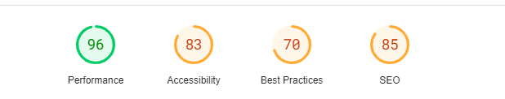
1. Initial Audit:

Slide 4
Performance: Overall score is 76 out of 100%. The response time is under 0.2 seconds.
Strength: One or more keywords were found in the title and description of the page. One H1 tag was found on the page. H2 tags were found on the page. The page is using the canonical link tag. The page does not contain any noindex header or meta tag. Both the www and non-www versions of the URL are redirected to the same site. The site has a robots.txt file. We found Schema.org data on the page. All CSS files appear to be minified. The page makes 19 requests. The size of the HTML document is 8 Kb. This is under the average of 33 Kb. Directory Listing seems to be disabled on the server. Google has not flagged this site for malware. The site is using a secure transfer protocol (https).
Weakness: The meta description is 269 characters long. Some images on the page have no alt attribute. (9) Too few internal links on the page. Some Open Graph meta tags are missing. The server is not using "expires" headers for the images. Some Javascript files don't seem to be minified.

Slide 5
2. Keyword Research

Slide 6
Primary Keyword is: POS Software
Secondary Keyword
Restaurant Software [1K – 10K searches]
Salon Software [1K – 10K searches]
Long tail Keyword for POS Software
Best POS software for retail
Cloud-based POS software
POS software comparison

Slide 7
3. OnPage SEO

Slide 8
Page1 : https://www.gofrugal.com/
Title: Gofrugal | ERP Software for Retail, Restaurant, & Distribution Industries
Description: ERP system is a comprehensive billing to balance sheet solution scalable to meet the needs of any business. Our…..
Head: <H1> Omnichannel ERP made easy for retail, restaurants and distribution
Alt text: missing some images
Link: Links are present
Feedback: Keyword not optimized properly.
Action Item:
Utilize the key words on title, description and head tag.
Some images did not have alt text, add relevant alt text for these images.

Slide 9
Page2 : https://www.gofrugal.com/retail/
Title: Retail POS with billing software for retail shops
Description: Retail POS software helps retail shops manage billing, inventory, accounting, and more. Try Gofrugal's free retail POS billing software for retail stores now!
Head: <H1> Best Retail POS Software with POS billing designed uniquely for all Retail shops
Feedback: Title, desc., heading keyword is not same.
Alt text: Present but some images title was missing
Link: Links are present
Feedback: Keywords are not optimized properly
Action Item:
Utilize the key words on title, description and head tag.
Some images did not have alt text, add relevant alt text for these images.

Slide 10
Page3 : https://www.gofrugal.com/restaurant/
Title: Restaurant Management System | Restaurant ERP Software
Description: Restaurant management system designed to manage all the restaurant operations from a single ERP software. Try Gofrugal's Online Restaurant ERP software for free!
Head: <H1> A restaurant management system with advanced features Beyond a POS
Alt text: Present but some images title was missing
Link: Links are present
Feedback: Keywords are not optimized properly
Action Item:
Utilize the key words on title, description and head tag.
Some images did not have alt text, add relevant alt text for these images.

Slide 11
4. Technical SEO

Slide 12
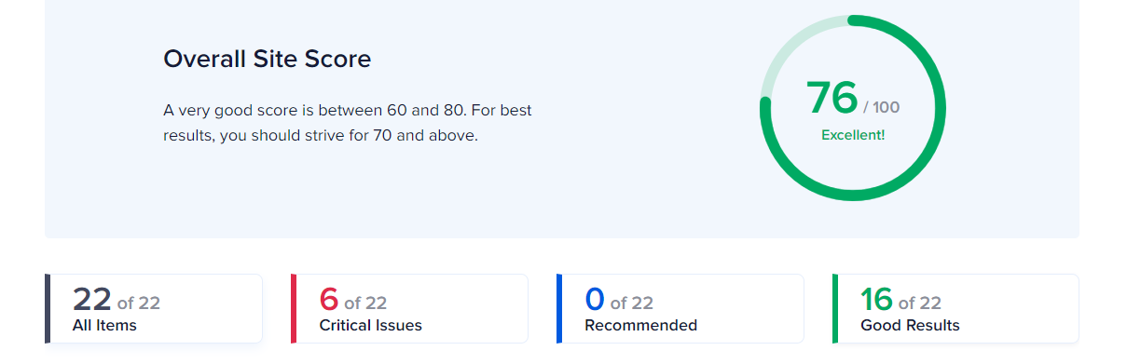
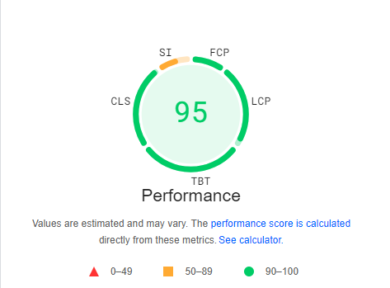
Overall Site Score

Slide 13
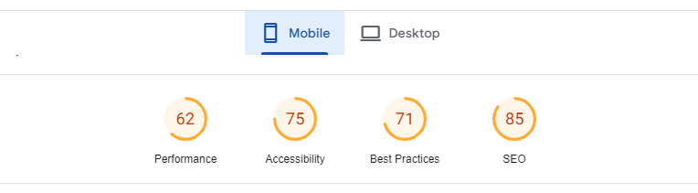
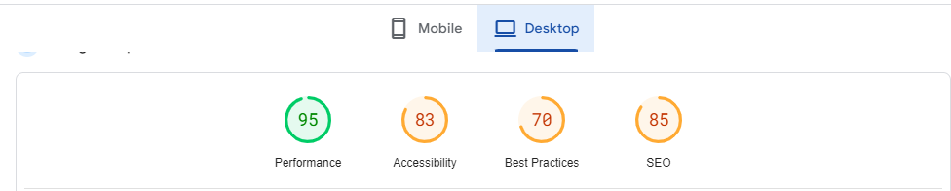
Site performance Mobile/Desktop

Slide 14
SEO Issues
Homepage Issue
The meta description is 269 characters long, which is too long.
Some images on the page have no alt attribute. (9)
Too few internal links on the page.
Some Open Graph meta tags are missing.
The server is not using "expires" headers for the images.
Some Javascrip
Retail Page
Some Open Graph meta tags are missing.
The server is not using "expires" headers for the images.
Some Javascript files don't seem to be minified.
Some CSS files don't seem to be minified.
The page makes 22 requests. More than 20 requests can result in slow page loading.
Restaurant
The meta description is 161 characters long, which is too long.
Some Open Graph meta tags are missing.
The server is not using "expires" headers for the images.
Some Javascript files don't seem to be minified.
Some CSS files don't seem to be minified.
The page makes 26 requests. More than 20 requests can result in slow page loading.

Slide 15
Practices to improve
Mobile
Eliminate render-blocking resources Potential savings of 1,230 ms
Largest Contentful Paint element 4,110 ms
Minimize main-thread work 3.9 s
Avoid an excessive DOM size 1,128 elements
Reduce unused JavaScript Potential savings of 60 KiB
PC
Reduce unused JavaScript Potential savings of 60 KiB
Eliminate render-blocking resources Potential savings of 260 ms
Image elements do not have explicit width and height
Serve images in next-gen formats Potential savings of 58 KiB
Reduce unused CSS Potential savings of 25 KiB
Avoid an excessive DOM size 1,138 elements

Slide 16
5. Content Strategy

Slide 17
Create Blogs for following heading
How POS Software Can Transform Your Business Operations
Case Studies: How Businesses Are Thriving with POS Software
Why Your Business Needs POS Software in 2024 and Beyond
POS Software Reviews: What Users Are Saying
Regularly update with new content and publish
Keep promoting on social media

Slide 18
6. Off-Page SEO

Slide 19
Off-Page SEO Plan and Strategy:
Competitor Analysis
Find your top competitors in search rankings.
Analyze the backlink profiles of competitors.
Identify the sources and types of links they are getting..
Analyze the types of content your competitors are promoting off-site (e.g., guest posts, infographics, videos) and see what is working well for them.
Backlink Building
Reach out to industry-relevant blogs and websites to contribute guest posts. Ensure that your content is high-quality and provides value
Find broken links on relevant sites and suggest your content as a replacement. This is a value-driven way to gain backlinks.
Create content that is better than what's currently ranking and reach out to sites linking to the original content, suggesting they link to your improved version
Content Marketing
Develop comprehensive guides, infographics, or interactive content that others in your niche will want to link to.
Collaborate with influencers in your industry to promote your content or website. This can generate social shares and backlinks.
Republish your content on platforms like Medium or LinkedIn with canonical links to your website to avoid duplicate content penalties

Slide 20
Social Media Engagement
Create content that is easily shareable on social media platforms. Engaging infographics, videos, and listicles work well.
Content Collaboration and Partnerships
Collaborate with other websites to exchange content that links back to your site.
Influencer and Blogger Outreach
Partner with bloggers in your niche for reviews, mentions, or guest posts.
Monitor and Adjust
Regularly monitor your backlink profile using tools like Google Search Console, Ahrefs, or Moz.
Use Google Analytics to identify which off-page activities are driving traffic and conversions.
Based on performance data, adjust your off-page SEO tactics to focus on the most effective channels.

Slide 21
Thank You

